Slide 1
GEO & ES GEO

Slide 2

一个实例

Slide 3

V1:位置过滤
采集位置数据，从库里匹配

Slide 4
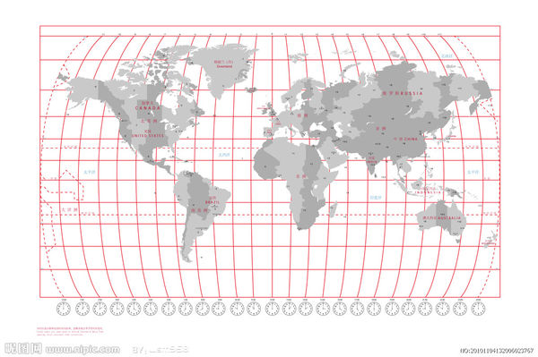
V2:经纬度条2元索引
Lat:1→g1, g2, g3...
Lat:2->g1`, g2`, g3`…
Lon:1→G1, G2, G3...
Lon:2->G1`, G2`, G3`…

Slide 5
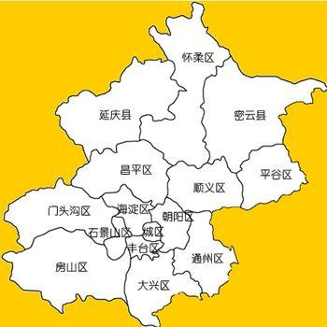
V3:数据分块

Slide 6
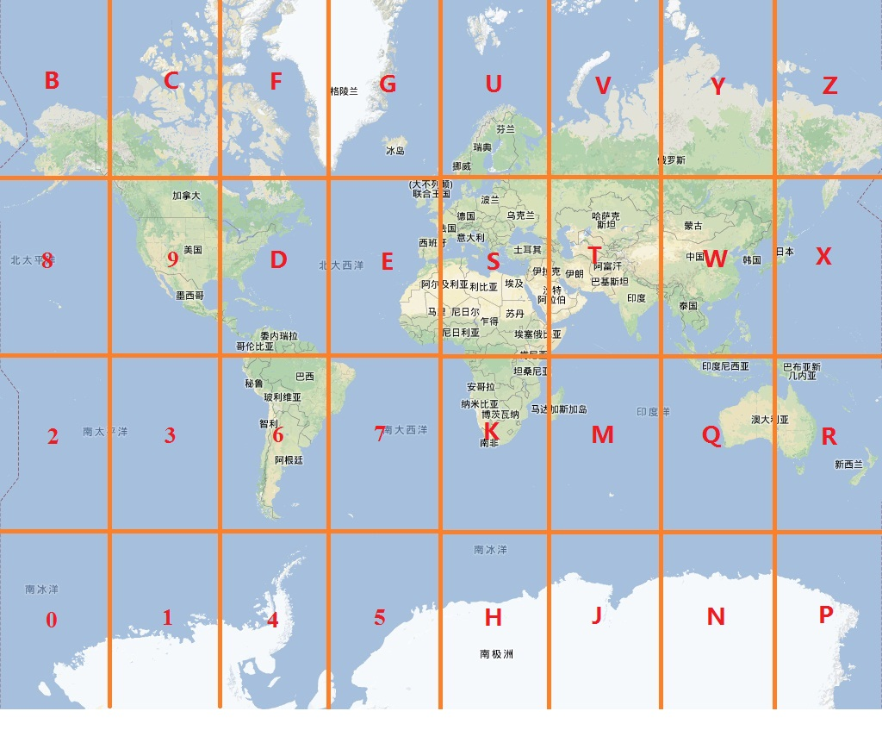
V4:动态分块

Slide 7
GEO要处理的问题
点和点的关系
点和面的关系
面和面的关系

Slide 8
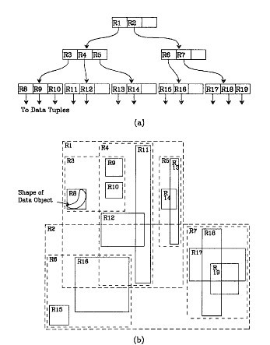
GEO相关的其他一些东西
R树

Slide 9
ES GEO
geo_point
Mapping
Indexing
filter
Geo_shape
Mapping
Indexing
querying

Slide 10
geo_point-mapping
"location": {
"type": "geo_point“
}

Slide 11
geo_point- indexing
PUT /attractions/restaurant/1
{
"location": "40.715, -74.011"
//"location": {
//"lat": 40.722,
//"lon": -73.989
//}
//"location": [-77.03653, 38.897676]
}

Slide 12
filter:
geo_bounding_box
geo_distance
geo_distance_range
geo_polygon

Slide 13
geo_bounding_box filter
"filter": {
"geo_bounding_box": {
//"type": "indexed", //default: memory
"location": {
"top_left": {
"lat": 40.8,
"lon": -74.0
},
"bottom_right": {
"lat": 40.7,
"lon": -73.0
}
}
}
}

Slide 14
geo_distance filter
"filter": {
"geo_distance": {
"distance": "1km",
"distance_type": "plane", //arc,sloppy_arc
"location": {
"lat": 40.715,
"lon": -73.988
}
}
}

Slide 15
geo_distance_range filter
"filter": {
"geo_distance_range": {
"gte": "1km", //gt
"lt": "2km", //lte
"location": {
"lat": 40.715,
"lon": -73.988
}
}
}

Slide 16
Geo-hash
"location": {
"type": "geo_point“
“lat_lon”:”true”//false
geohash: true
geohash_precision:1
geohash_prefix:true/false
}

Slide 17
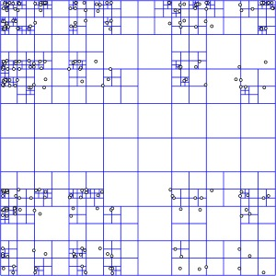
Geo-hash-思路

Slide 18
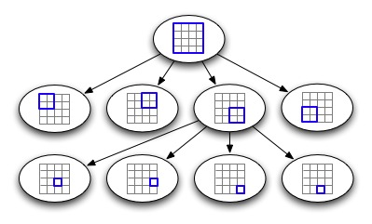
Geo-hash-索引

Slide 19
编码
bit | min | mid | max
1 | -180 | 0.000 | 180
1 | 0.000 | 90 | 180
0 | 90 | 135 | 180
1 | 90 | 112.5 | 135
0 | 112.5 | 123.75 | 135
0 | 112.5 | 118.125 | 123.75
1 | 112.5 | 115.3125 | 118.125
0 | 115.3125 | 116.71875 | 118.125
1 | 115.3125 | 116.015625 | 116.71875
1 | 116.015625 | 116.3671875 | 116.71875
(116.389550, 39.928167)
11010 01011

Slide 20
编码
bit | Min | mid | max
1 | -90.000 | 0.000 | 90.000
0 | 0.000 | 45.000 | 90.000
1 | 0.000 | 22.500 | 45.000
1 | 22.500 | 33.750 | 45.000
1 | 33.7500 | 39.375 | 45.000
0 | 39.375 | 42.188 | 45.000
0 | 39.375 | 40.7815 | 42.188
0 | 39.375 | 40.07825 | 40.7815
1 | 39.375 | 39.726625 | 40.07825
1 | 39.726625 | 39.9024375 | 40.07825
(116.389550, 39.928167)
10111 00011

Slide 21
编码
1 0 1 1 1 0 0 0 1 1 ----纬度
1 1 0 1 0 0 1 0 1 1 经度
11100 11101 00100 01111
…base32

Slide 22
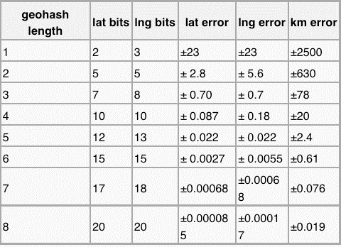
Geo-hash-精确度

Slide 23
Geo-hash filter
"filter": {
"geohash_cell": {
"location": {
"lat": 40.718,
"lon": -73.983
},
"neighbors": true,
"precision": "2km"
}

Slide 24
Es geo-point说明
lat/lon几乎无用
Geohash不能单独存在
Geohash不能在不索引前缀的情况下指定精度
使用前缀时容易导致索引膨胀

Slide 25
Es geo-point使用建议
在了解业务的情况下针对一个点只建一个geohash term

Slide 26
Geo_shape:used for
intersects
disjoint
within

Slide 27
Geo_shape-mapping
"mappings": {
"landmark": {
"properties": {
"location": {
"type": "geo_shape"
}
}
}
}

Slide 28
indexing
PUT /attractions/landmark/dam_square
{
"location" : {
"type" : "polygon",
"coordinates" : [[
[ 4.89218, 52.37356 ],
[ 4.89205, 52.37276 ],
[ 4.89301, 52.37274 ],
[ 4.89392, 52.37250 ],
[ 4.89431, 52.37287 ],
[ 4.89331, 52.37346 ],
[ 4.89305, 52.37326 ],
[ 4.89218, 52.37356 ]
]]
}
}

Slide 29
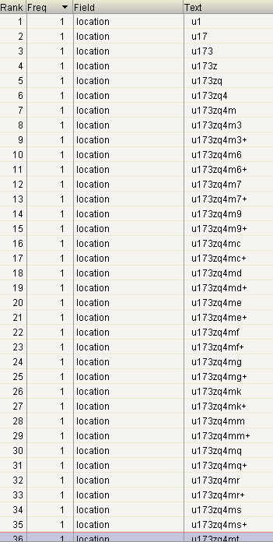
index

Slide 30
querying
"query": {
"geo_shape": {
"location": {
"relation": "within", //default:intersects, disjoint
"shape": {
"type": "circle",
"radius": "1km"
"coordinates": [
4.89994,
52.37815
]
}
}
}
}

